Slide 1
Error
Error is a mistake.
Types:
Compile time
The compile-time errors are usually detected while the source code is being compiled to the object code.
Every programming language has some rules to be followed for the instruction to be properly interpreted by the compiler. Any violation of rules of the programming language results in syntax errors.
When you hit the compile button, the compiler takes in the complete source code as an input and then checks for the errors and displays all the errors in a single take.
Runtime error
The runtime error is a type of programming error that is encountered during the program execution. It would not display the error while compiling the source code

Slide 2
Logical error
As the name itself implies, these errors are related to the logic of the program. Logical errors are also not detected by compiler and cause incorrect results. These errors occur due to incorrect translation of algorithm into the program, poor understanding of the problem and a lack of clarity of hierarchy of operators.

Slide 3
Exception handling
Try
Except
Finally
Assert
Raise
Try
it contains error statements. that throws an error to except block
Except:
Except block receives a error and handle it
We can provide more except block
Finally → finally block can be executed at the end of exception handling.it is optional
If we give finally then it should be executed whether error is coming or not
Eg:exception → ImportError, NameError: name 'x' is not defined, ZeroDivisionError,
ValueError→ aised when a function gets an argument of correct type but improper value.
import math
print(math.factorial(2))
Print(x)→ NameError: name 'x' is not defined,

Slide 4
a=10
b=0
c=a/b
d=a+b
print(c)
print(d)
How to handle:
a=10
b=0
try:
c=a/b
print("a/b=",c)
except:
print("i got ZeroDivisionError...divider no is zero!")
d=a+b
print("a+b=",d)

Slide 5
Finally
try:
c=a/b
print("a/b=",c)
except:
print("i got ZeroDivisionError...divider no is zero!")
d=a+b
print("a+b=",d)
Finally:
print(“Error handled”)

Slide 6
a=10
b=0
try:
print(x)
c=a/b
print("a/b=",c)
except ZeroDivisionError as e:
print(e)
except NameError as e:
print(e)
d=a+b
print("a+b=",d)
Finally:
print(“Error handled”)

Slide 7
raise
a=10
b=0
try:
if(b==0):
raise ZeroDivisionError ("divisor=0")
print( a/b)
except ZeroDivisionError as e:
print(e)
finally:
print("a=",a,"b=",b)
print("End of the program")

Slide 8
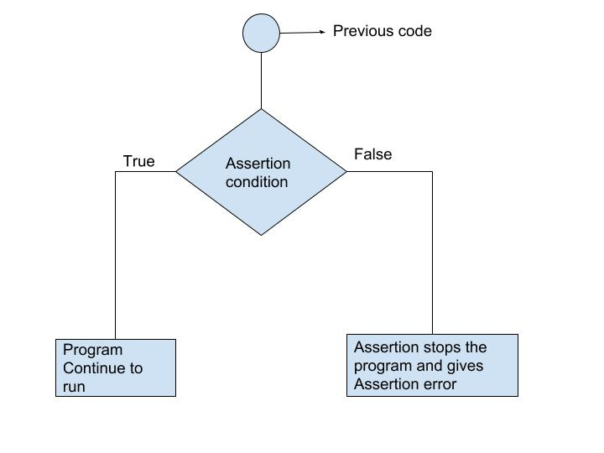
Assertions are statements that assert or state a fact confidently in your program. For example, while writing a division function, you're confident the divisor shouldn't be zero, you assert divisor is not equal to zero.
Assertions are simply boolean expressions that check if the conditions return true or not. If it is true, the program does nothing and move to the next line of code. However, if it's false, the program stops and throws an error.
It is also a debugging tool as it brings the program on halt as soon as any error is occurred and shows on which point of the program error has occurred.
We can be clear by looking at the flowchart below:

Slide 9
Python assert Statement
Python has built-in assert statement to use assertion condition in the program. assert statement has a condition or expression which is supposed to be always true. If the condition is false assert halts the program and gives an AssertionError
Syntax for using Assert in Pyhton:
assert <condition> or assert <condition>,<error message>
In Python we can use assert statement in two ways as mentioned above.
assert statement has a condition and if the condition is not satisfied the program will stop and give AssertionError.
assert statement can also have a condition and a optional error message. If the condition is not satisfied assert stops the program and gives AssertionError along with the error message.
Let's take an example, where we have a function which will calculate the average of the values passed by the user and the value should not be an empty list. We will use assert statement to check the parameter and if the length is of the passed list is zero, program halts.

Slide 10
Assertion with out error message Assertion with error message
a=10
b=0
assert b!=0
print(a/b)
The AssertionError is also a built-in exception that can be handled using try-except
a=10
b=0
assert b!=0,"b=0 it should not zero"
print(a/b)
a=10
b=0
try:
assert b!=0, " bcz b=0 make sure b is not equal to zero"
print(a/b)
except AssertionError as msg:
print(msg)
finally:
print("assertion Error handled")

Slide 11
Key Points to Remember
Assertions are the condition or boolean expression which are always supposed to be true in the code.
assert statement takes an expression and optional message.
assert statement is used to check types, values of argument and the output of the function.
assert statement is used as debugging tool as it halts the program at the point where an error occurs

Slide 12
Assert
When it encounters an assert statement, Python evaluates the accompanying expression, which is hopefully true. If the expression is false, Python raises an AssertionError exception. If the assertion fails, Python uses ArgumentExpression as the argument for the AssertionError
a="hellow"
assert (a=="hellow"),"This assertion is for equality"
print(a)

Slide 13
Create User Defined Exception in Python
Step 1: Create User Defined Exception Class
class YourException(Exception):
def __init__(self, message):
self.message = message
Step 2: Raising Exception
raise YourException(“my own exception")
Step3:Catching Exception
except YourException as err:
print(err.message)

Slide 14
Step 4: Write a Program for User-Defined Exception in Python
class YourException(Exception):
def __init__(self, message):
self.message = message
a=12
b=0
try:
if(b==0):
raise YourException("dont give o for divisor bcz it will not accept infinitve")
except YourException as err:
# perform any action on YourException instance
print("Message:", err.message)
finally:
print("My own exception is created and handled properly")

Slide 15
Use assertionerror for zerodivision error and handle this error using try and except block
Manually raise the valueerror exception when user gives negative integer values
Raise valueerror exception when user enter the age<18
Implement exception handling in IndexError
To by a pizza in a shop minimum prize should be 250..check the user If they have money more than minimum prize.. Based on this condition mension assertion error.. If does not have enough money raise AssertionError exception and handle the exception using try.. Except..

